Slide 1



PLAGIARISM DETECTION USING KMP ALGORITHM
A Case Study on Efficient Text Matching
Grp -9

Slide 2
OVERVIEW
  Introduction
  Case Study – real –world Application
  Why detect plagiarism
  Test Cases
  Exiting Methods vs KMP algorithm
  Code implementation
  Time Complexity
  How KMP algorithm works ?
  Conclusion

Slide 3
INTRODUCTION
Plagiarism is the act of using someone else's work, ideas, or intellectual property without proper acknowledgment and presenting it as one’s own. It can occur in writing, coding, research, or creative work and is considered unethical.
Impact of Plagiarism:
  Academic Consequences – Leads to failing grades, academic probation, or expulsion.
  Research Integrity Issues – Undermines trust in scholarly work and can result in paper retractions.

Slide 4
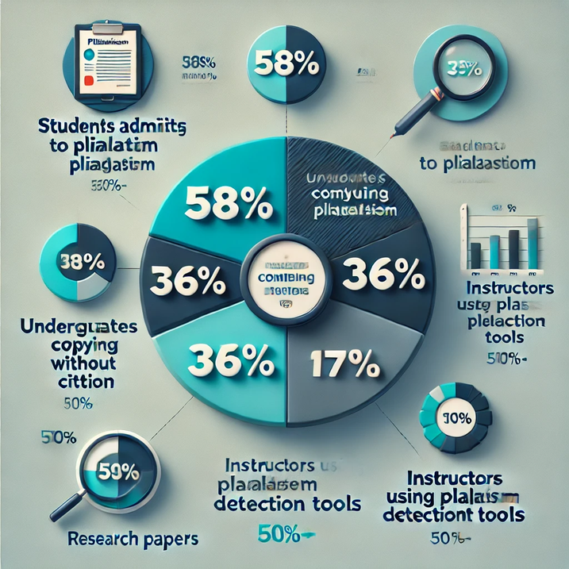
WHY DETECT PLAGIARISM?
  Detecting plagiarism is essential to maintain academic and professional integrity. It ensures originality, promotes ethical behavior, and upholds the credibility of research and education.
The Importance of Academic Integrity :
  Preserves Educational Standards – Encourages independent thinking and fair evaluation.
  Maintains Research Credibility – Ensures trust in scholarly work and prevents misinformation.
  Prevents Legal and Ethical Violations – Avoids copyright infringement and professional misconduct.
  Statistics on Plagiarism in Education
  Around 58% of students admit to plagiarism at some point.
  36% of undergraduates have copied text without citation.
  17% of research papers submitted contain some form of plagiarism.
  More than 50% of instructors use plagiarism detection tools.

Slide 5
EXISTING METHODS VS. KMP ALGORITHM
Method | Best Case complexity | Worst case complexity | notes
Brute Force | O(n × m) | O(n × m) | Simple but slow for large texts
Hashing | O(n) | O(n) | Efficient but requires extra space
KMP Algorithm | O(n + m) | O(n + m) | Efficient with preprocessing
Rabin-Karp | O(n) (if no collisions) | O(n × m) (with hash collisions) | Uses hashing for quick comparisons
Boyer-Moore | O(n/m) (best case) | O(n × m) | Efficient for long patterns in large texts
Traditional Methods for Plagiarism Detection:
  Brute Force Method
  Compares every substring of the source text with the target text.
  Time Complexity: O(n × m) (slow for large texts).
Hashing-Based Method:
  Converts substrings into hash values and compares them.
  Time Complexity: O(n) (but high space usage).
Why KMP Algorithm for Plagiarism Detection?
  Efficient String Matching: Works in O(n + m) time, making it faster than brute force.
  Pattern Preprocessing: Avoids unnecessary comparisons, improving performance.
  Lower Space Complexity: Uses only extra O(m) space for preprocessing.

Slide 6
HOW KMP ALGORITHM WORKS ?
Step-by-Step Breakdown of the KMP Algorithm :
The KMP algorithm is an efficient string-matching algorithm that improves on brute-force matching by preprocessing the pattern using an LPS (Longest Prefix Suffix) array.
1. Preprocessing Step: Compute the LPS Array :
The LPS array helps in skipping unnecessary comparisons during the search.
How the LPS Array is Built :
  The LPS array for a pattern stores the length of the longest proper prefix that is also a suffix.
  It prevents unnecessary comparisons, making the KMP algorithm efficient.

Slide 7

CASE STUDY - REAL-WORLD
APPLICATION
SCENARIO: DETECTING PLAGIARISM IN STUDENT ASSIGNMENTS
  A university wants to ensure academic integrity by detecting plagiarism in student assignments.
  The system compares each student’s submission against previously submitted assignments and online sources.
Test Case Setup :
  To demonstrate the effectiveness of the KMP Algorithm, we set up the following:
1. Main Document (Original Content)
  A reference document (e.g., a professor’s lecture notes or an assignment template).
2. Three Pattern Documents (Submitted Assignments)
  Pattern 1: A student’s assignment with exact copied content from the main document.
  Pattern 2: A student’s assignment with partially reworded content and slight modifications.
  Pattern 3: A completely original submission with no copied content.

Slide 8
TEST CASES
Insights
  Test 1: Since the submission is nearly identical, the KMP algorithm efficiently detects plagiarism.
  Test 2: Some content is copied, but modifications make it harder to detect, resulting in partial plagiarism.
  Test 3: The student's work is original, leading to a 0% plagiarism score.
Test Case | Description | Plagiarism Score (%) | Detection Outcome
Test 1 | Student submission is an exact copy of the main document. | 90% | High Plagiarism Detected
Test 2 | Student submission has partial matches, with some rewording and minor modifications. | 50% | Moderate Plagiarism Detected
Test 3 | Student submission is completely original, with no matching content. | 0% | No Plagiarism Detected

Slide 9
IMPLEMENTATION IN CODE
  Implementation File:
  The full code implementation is provided separately as a C++ source file.
  The program reads input files, applies the KMP algorithm, and computes plagiarism similarity scores.
  Efficient text matching ensures accurate plagiarism detection.

Slide 10
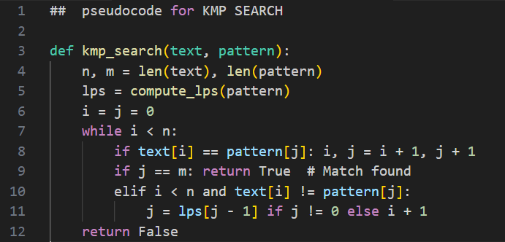
TIME COMPLEXITY OF CODE
  The time complexity of plagiarism detection using the KMP algorithm is mainly influenced by reading files, computing the LPS array, and searching for matches. Reading the text takes O(N), computing the LPS array takes O(M), and performing the KMP search runs in O(N + M). Since we compare each word in the pattern document (with P words) against the text, the worst-case complexity becomes O(PN). This is significantly more efficient than brute force O(N × M), making KMP a fast and optimized choice for plagiarism detection
Function | Time Complexity
read_file() | O(N)
compute_lps() | O(M)
kmp_search() | O(N+M)
compute_similarity() | O(PN)
N → Length of the text document (main file content).
M → Length of the pattern (query) document (plagiarism-check file).
P → Number of words in the pattern document.
Thus, O(PN) comes from checking each P words in the pattern against the entire N-length text using KMP (O(N + M)), leading to O(PN) in the worst case.

Slide 11
CONCLUSION & FUTURE SCOPE
Conclusion :
  Plagiarism detection is a crucial aspect of maintaining academic and professional integrity. The KMP algorithm, with its efficient pattern-matching capability, provides a strong foundation for detecting exact matches in documents. However, it faces limitations when dealing with complex plagiarism techniques like paraphrasing and synonym substitution. While KMP is effective in identifying direct text duplications, advanced techniques involving AI and natural language processing (NLP) are required for a more comprehensive detection system.
Future Scope:
  Handling Paraphrasing & Synonym Recognition – Future advancements can integrate NLP techniques, such as word embeddings (Word2Vec, GloVe) or transformers (BERT, GPT), to identify meaning-based similarities rather than just exact matches.
  AI-Based Plagiarism Detection – Machine learning models trained on large datasets can improve the detection of subtle forms of plagiarism, including sentence restructuring and synonym replacement.

Slide 12
PRESENTED BY
Roll no : CB.SC.U4CSE23640
NAME : P Sreeshanth Reddy
Roll no : CB.SC.U4CSE23650
NAME : Rudrapaka Akhil
Roll no : CB.SC.U4CSE23655
NAME : D Uday Kumar
Roll no : CB.SC.U4CSE23663
NAME : P Bhanu Prakash Reddy

Slide 13
Thank You

